Slide 1
Molding and Growing: How to be a better teacher through professional development opportunities
Dr. Julie Saam
Associate Professor of Education
FACET Class of 2006
Indiana University Kokomo

Slide 2
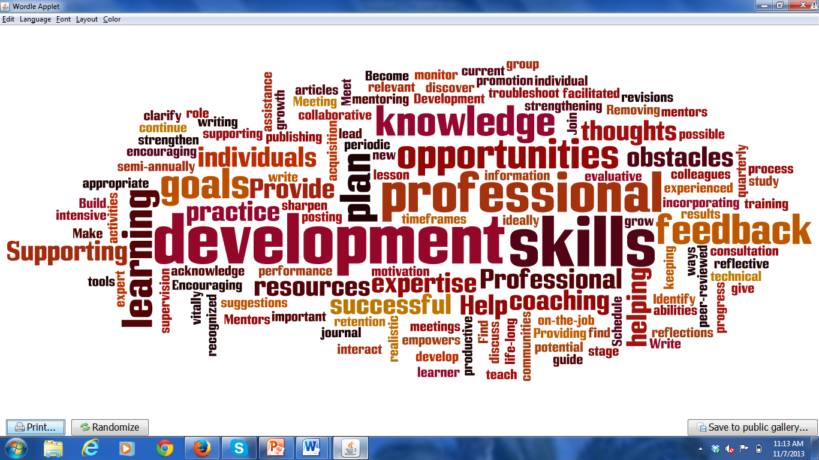
Professional Development

Slide 3
Avenues for Developing our Teaching Profession
Reading professional journals
Professional conferences within discipline
Professional conferences in teaching and learning
Online workshops
Face-to-Face workshops
Campus level/University system-wide
Twitter/Blogs
Listserves/Email newsletters
Peer review/Coaching
Analyzing assessment data

Slide 4
Developing What Parts of our Teaching Profession
Content Knowledge
Current vocabulary
Current content
Current events
Pedagogical Knowledge
Instructional Strategies
Assessment Strategies
Technological Innovations

Slide 5
Process for Improvement
Identify Issue
Identify resources
Develop a plan
Implement plan
Gather data
Analyze data
Reach conclusion

Slide 6
For Example
Identify Issue | Student were not utilizing feedback to make improvements on subsequent assignments
Identify resources | Twitter follow with The Teaching Professor identified a blog
Develop and Implement a plan | Read the blog and revised suggestions to work on my classroom with my students
Gather and Analyze data | This does not need to be formal.
Reach conclusion | Are you going to keep the strategy or not?

Slide 7
Group work with Cases
Instructional strategies
I teach non-majors and need help connecting the students to the course content.
I want to move my students beyond opinion to critical thinking.
Assessment strategies
My exams do not evaluate higher level thinking.
I currently have one mid-term and one final exam. I am thinking about adding more tests and quizzes.
Technological Innovations
I would love to increase participation in online and face-to-face discussions.
I have difficult material that students struggle with each year. I need a way to chunk this material in a manageable accessible format.

Slide 8
Group Work
Find the statement that fits your needs
In your groups,
Identify where would be likely places to find resources
Brainstorm possible solutions
Identify one that you might like to research further
Identify at least one member to share his/her plan

Slide 9
National and Local Resources
Professional Organizations
The Teaching Professor
Campus Teaching and Learning Centers
FACET events
Peer Review/Coaching

Slide 10
Benefits
Improved teaching
Improved student learning
Improved course evaluations
Inclusions for annual reports
Data for teaching awards

