Slide 1
When a Curriculum You Must Create, a Jedi You Must Become
When a Curriculum You Must Create, a Jedi You Must Become
William Emigh & Erika Lee
IU Bloomington

Slide 2
Introduction
Erika Lee & Will Emigh
Visiting Lecturer & Lecturer
New Media School curriculum
New courses, adjusting old courses
“We meet again, at last. The circle is now complete.”
Notes:
http://www.unwinnable.com/wp-content/uploads/2011/09/darth-vader.png

Slide 3
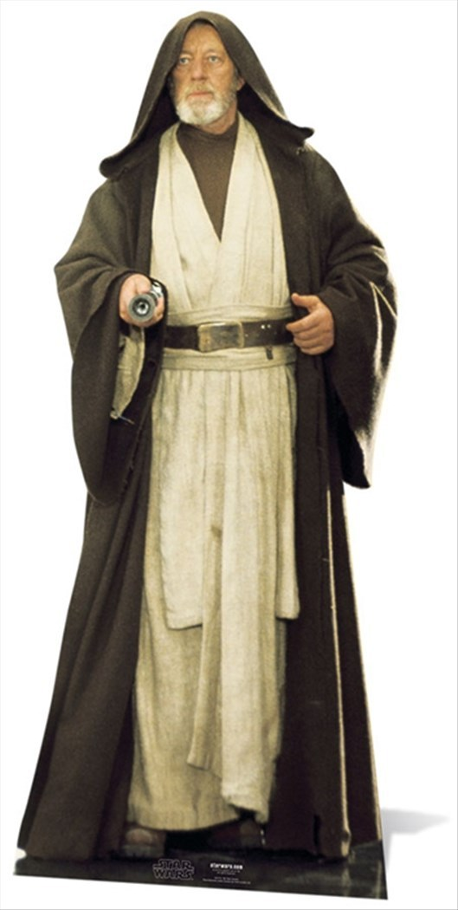
Course Creation
What do students already know?
What needs to be introduced?
What needs to be reinforced?
What needs to be assessed?
Stormtrooper: Let me see your identification.
Ben Obi-Wan Kenobi: You don't need to see his identification.
Notes:
http://cdn1.bigcommerce.com/n-ou1isn/ydriczk/products/87147/images/88181/Obi_Wan_Kenobi_Alec_Guinness_Star_Wars_cutout_buy_now_at_starstills__37037.1404456390.1280.1280.jpg?c=2

Slide 4
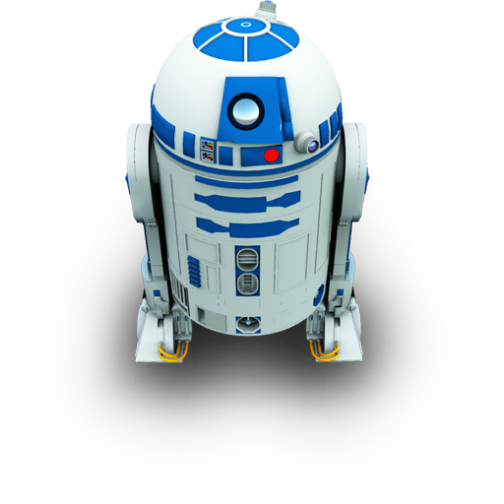
Curriculum Structure
How do you know?
Does everyone agree?
(Are we all speaking the same language here?)
It's an energy field created by all living things. It surrounds us and penetrates us. It binds the galaxy together.

Slide 5
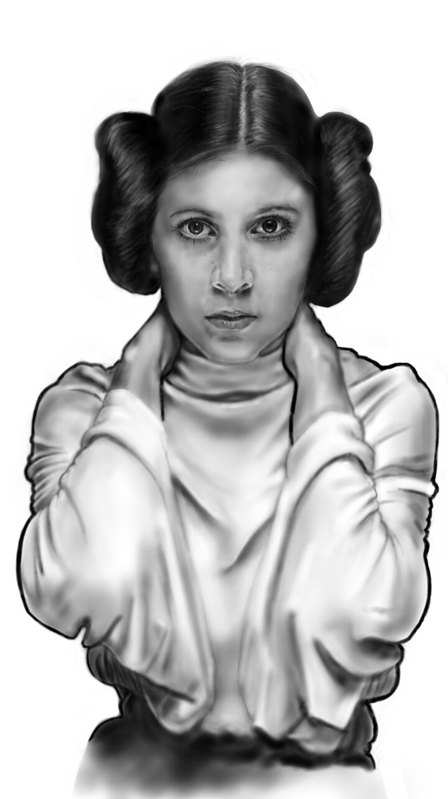
Curriculum Design
Think about your department’s curriculum:
What should your graduates be like? What will they know and be able to do? (Student Learning Outcomes)
Princess Leia Organa: I don't know who you are or where you came from, but from now on you'll do as I tell you, okay?
Notes:
http://th03.deviantart.net/fs71/PRE/f/2013/149/2/0/princess_leia_cellphone_drawing_by_thewalkingman-d671i23.jpg

Slide 6
Student Learning Outcomes
Concrete • Specific • Cognitive Process Dimensions
Examples of SLOs:
Identify major peoples, events, and themes in American and World History.
Analyze primary sources of evidence and historiographical literature and be able to interpret evidence critically.
Evaluate the usefulness of various anthropological research methods for the study of a specific problem by selecting one of the options and justifying your choice.
Princess Leia Organa: This is some rescue! You came in here, but didn't you have a plan for getting out?
Han Solo: [indicating Luke] He's the brains, sweetheart!
Notes:
Discuss at your table

Slide 7
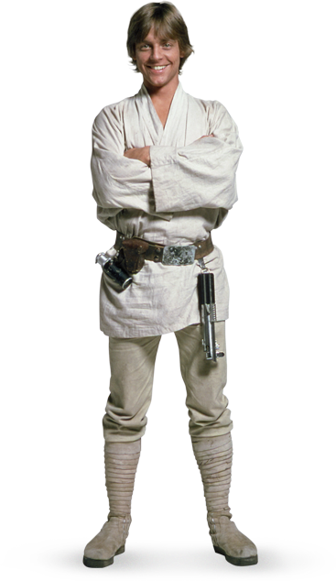
Curriculum Design
Where in your curriculum do those SLOs exist?
Which courses Introduce?
Reinforce? Assess?
Officer Cass: Our scout ships have reached Dantooine. They found the remains of a Rebel base, but they estimate that it has been deserted for some time. They are now conducting an extensive search of the surrounding systems.
Notes:
http://img2.wikia.nocookie.net/__cb20140504024532/deathbattle/images/c/ca/Luke-skywalker_starwars.png

Slide 8
Match Goals to Courses
Are your values reflected in your curriculum?
Where are there gaps?
Don't try to frighten us with your sorcerer's ways, Lord Vader.
Notes:
“creativity”
http://img4.wikia.nocookie.net/__cb20130919073020/villains/images/a/a9/Lord_Darth_Vader.jpg

Slide 9
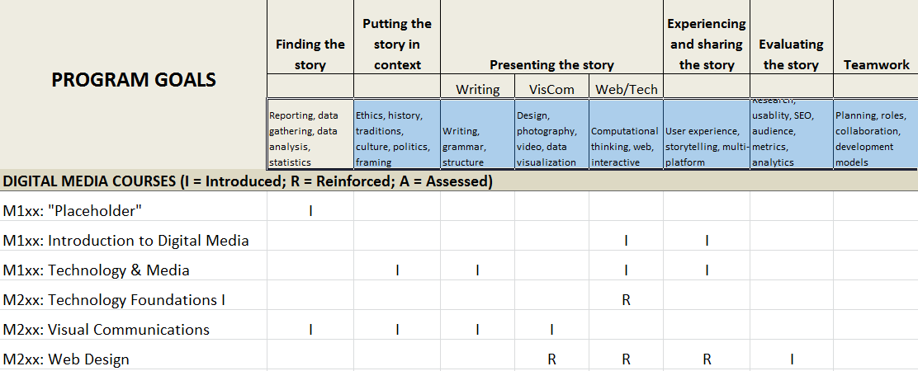
Notes:
Discuss at table

Slide 10
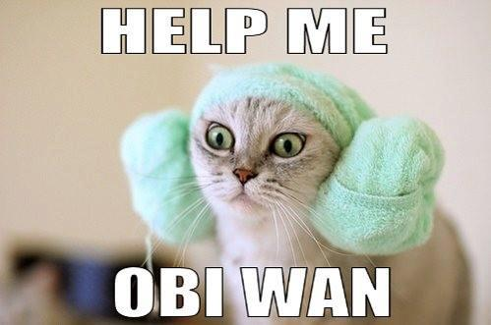
Share with your group
Are there gaps in the curriculum?
Are some SLOs given more priority than others?
How do you come up with SLOs?
Princess Leia: Help me, Obi-Wan Kenobi; you're my only hope.

Slide 11
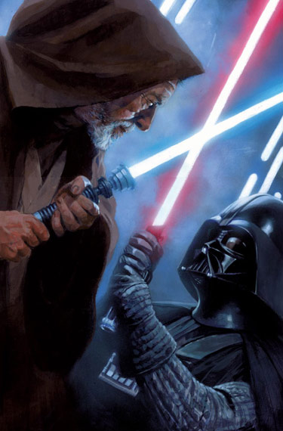
Backward Course Design
What SLOs are integral to YOUR course?
Darth Vader: I sense something; a presence I've not felt since...

Slide 12
Resources
Center for Innovative Teaching and Learning = CITL (IU Bloomington) Center for Instructional Excellence (Purdue)
CITL Backwards Course Design
http://decodingthedisciplines.org/
C-3PO: I see your point, sir. I suggest a new strategy, R2: let the Wookiee win.
Notes:
http://www.sideshowtoy.com/wp-content/uploads/2013/06/901863-product-silo1.png

Slide 13
Contact Us
Erika Lee ebigalee@indiana.edu
Will Emigh wemigh@indiana.edu
Ben Obi-Wan Kenobi: The Force will be with you, always.

